Slide 1
Chain
Noah Malhi
Prashant Kumar
Quentin Jimenez
Advisors:
Dov Kruger
Raghav Daga

Slide 2
Problem Statement
The String Class: - Array based object for streaming char - Insertion becomes a problem for large objects
Chain is an efficient tree structure for reading extremely large files.

Slide 3
Literature
Ropes

Slide 4
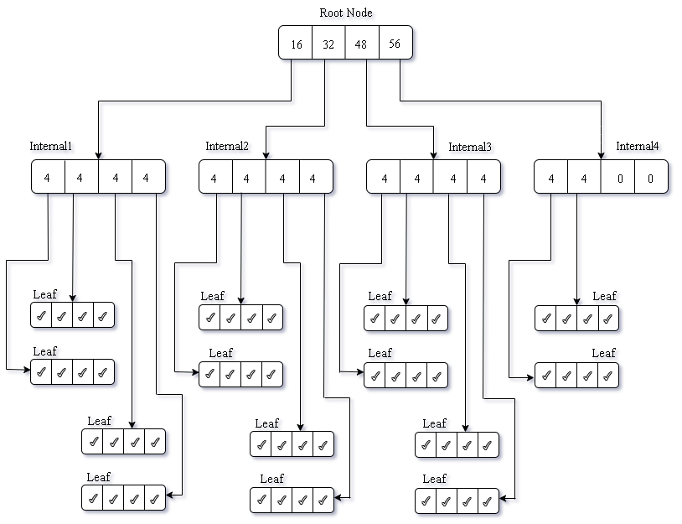
Structure
M-ary Trees.
Rules: at most m children Special cases: binary , ternary tree
Root Node- Pointer to internal nodes counter for #lines
Internal Nodes- Pointer to internal/leaf counter for #lines
Leaf Nodes Pointer to String (which is a line)

Slide 5
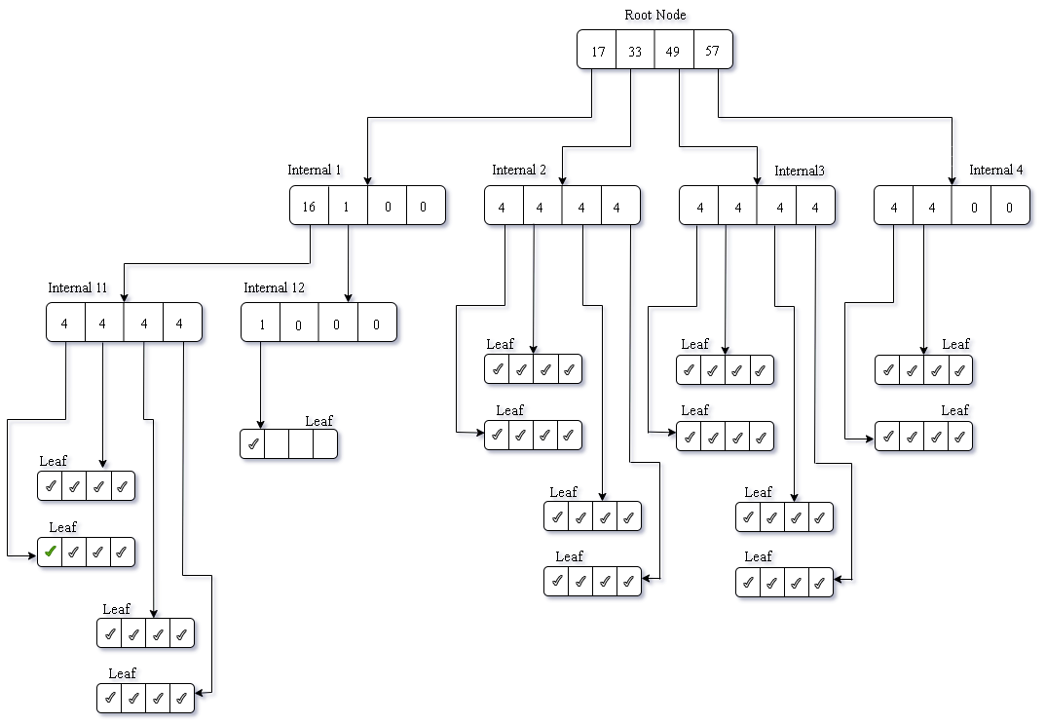
Insert start
Check space in Internal1
Split Internal1
Insert at pos1
Shift everything to right

Slide 6
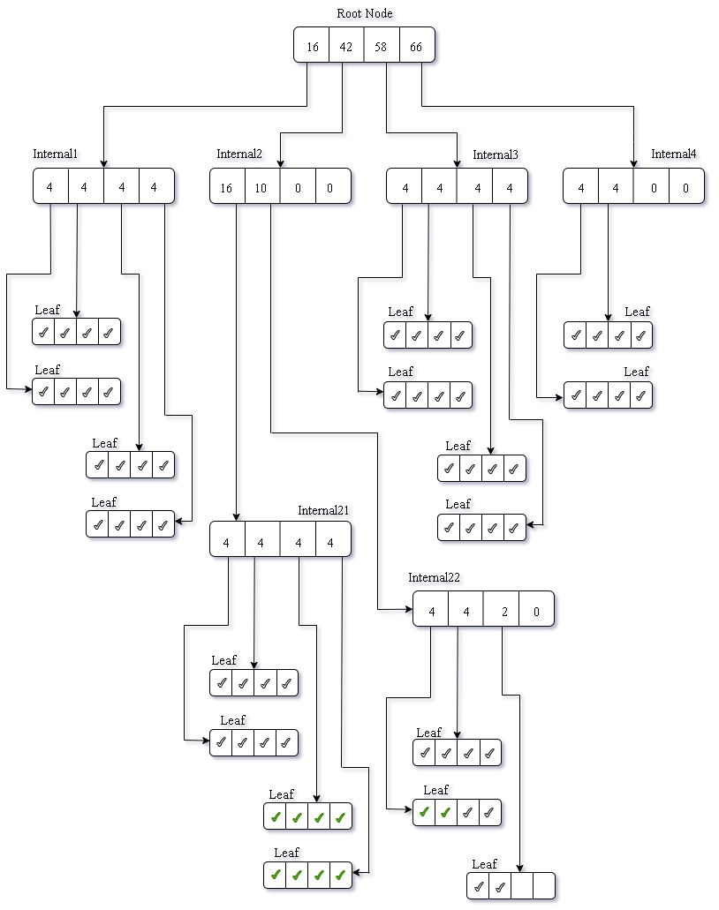
Insert middle
Insert 10 lines at pos 25

Slide 7
Base Struct: refer.
M-ary Trees.
Rules: at most m children Special cases: binary , ternary tree
Root Node- Pointer to internal nodes counter for #lines
Internal Nodes- Pointer to internal/leaf counter for #lines
Leaf Nodes Pointer to String (which is a line)

Slide 8
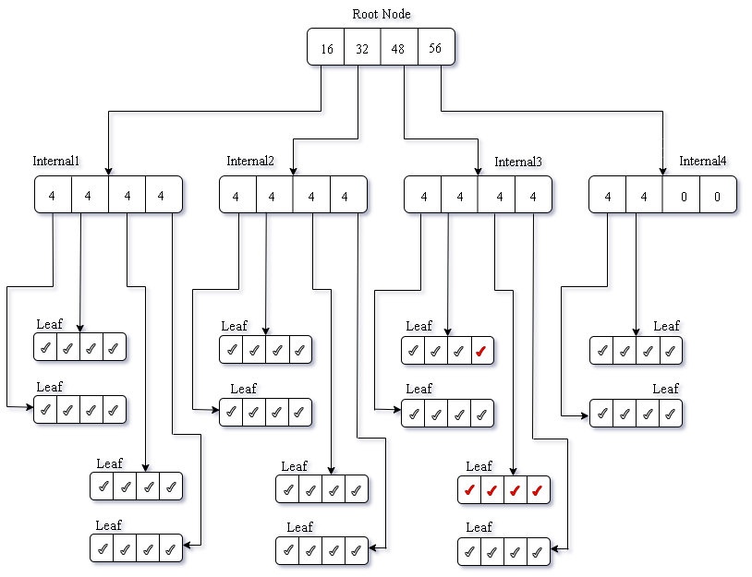
Delete-1
Delete 5 lines at pos 40

Slide 9
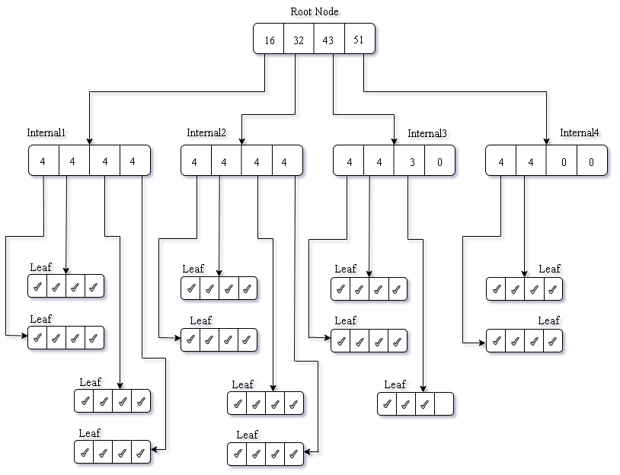
Delete-2

Slide 10
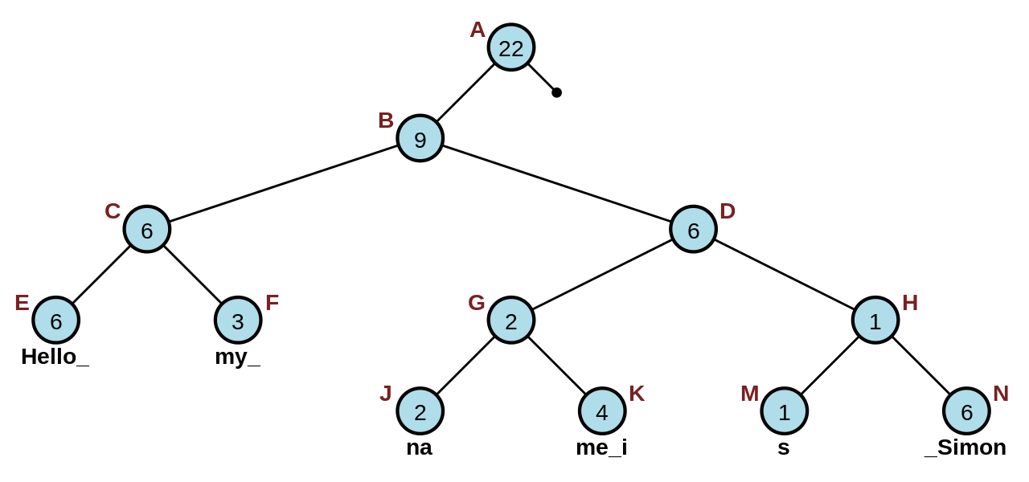
Literature
Ropes

Slide 11
How are we different?
Ropes

Slide 12
How are we different?
Ropes

